Slide 1


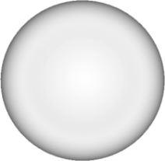

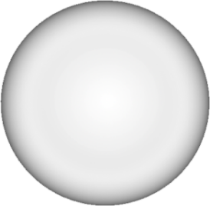
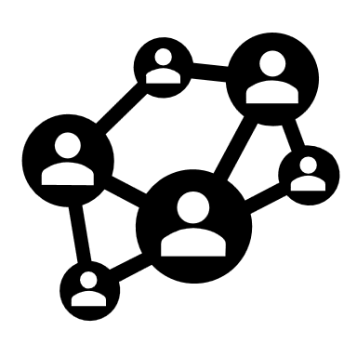







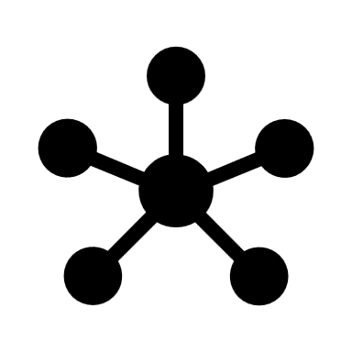


Key Components of Generative AI
Neural Networks
Machine Learning Models
Large Language Models (LLMs)
New Content
Data
Variational Autoencoders (VAEs)
Text
Generative Adversarial Networks (GANs)
Image
Voice

Slide 2



How Generative AI Works
Training
Generation
Refinement

Slide 3




Popular Generative AI Models
GPT
DALL-E
Stable Diffusion

Slide 4


Essential Generative AI Tools
Code
Text
Image

Slide 5







Practical Applications of Generative AI
Content Creation
Product Design
Healthcare and Drug Discovery

Slide 6






Overcoming Challenges in Generative AI
Challenges
Ethical Considerations
Bias Mitigation
Data Privacy and Security

Slide 7
Terms of use
We have released our work under the terms of Creative Commons’ license, that is Attribution-NoDerivatives 4.0 International (CC BY-ND 4.0). And every template you download from yourfreetemplates.com is the intellectual property of and is owned by us.
You are free to:
Use — make any necessary modification(s) to our PowerPoint templates to fit your purposes, personally, educationally, or even commercially.
Share — any page links from our website with your friends through Facebook, Twitter and Pinterest.
You are not allowed to:
Upload any of our PowerPoint templates, modified or unmodified, on a diskette, CD, your website or content share ones like Slideshare , Scribd, YouTube, LinkedIn, and Google+ etc.
Offer them for redistribution or resale in any form without prior written consent from yourfreetemplates.com.
For More details, please visit http://yourfreetemplates.com/terms-of-use/

