Slide 1
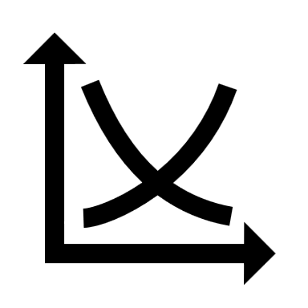
Understanding Relative Market Share (RMS)
Understanding Relative Market Share (RMS)
The ROS/RMS Matrix Explained
Conducting an RMS Analysis
Applying RMS Analysis Insights

Slide 2
Calculating RMS for market leaders and other companies
For the market leader
Next biggest competitor's market share
Market leader's market share
RMS
For all other companies
Company's market share
Market leader's market share
RMS

Slide 3
The ROS/RMS Matrix-1
High
Return on Sales (ROS)
Low
Low
Relative Market Share (RMS)
High

Slide 4
Interpreting the matrix quadrants-1
High
Low RMS, High ROS
High RMS, High ROS
Niche players with profitable market segments
Market leaders with strong profitability
Return on Sales (ROS)
Companies here face challenges in both market share and profitability
Have a significant market share but struggle with profitability
Low
Low RMS, Low ROS
High RMS, Low ROS
Low
Relative Market Share (RMS)
High
Notes:
market leaders with strong profitability

Slide 5
Interpreting the matrix quadrants-2
High
Low RMS, High ROS
High RMS, High ROS
Focus on premium products or specialized services
Benefit from economies of scale and brand strength
Return on Sales (ROS)
Reassess company strategies or consider exiting the market.
Face cost management issues or fierce price competition
Low
Low RMS, Low ROS
High RMS, Low ROS
Low
Relative Market Share (RMS)
High
Notes:
market leaders with strong profitability

Slide 6
Conducting an RMS Analysis
Gathering market share and profitability data
Plotting companies on the ROS/RMS matrix
Identifying trends and patterns in the matrix
Collect accurate market share and profitability data for the company and its competitors
Each company is represented by a bubble, with the size of the bubble indicating sales volume or net income
Understanding the relationship between market share and profitability in the industry

Slide 7
Terms of use
We have released our work under the terms of Creative Commons’ license, that is Attribution-NoDerivatives 4.0 International (CC BY-ND 4.0). And every template you download from yourfreetemplates.com is the intellectual property of and is owned by us.
You are free to:
Use — make any necessary modification(s) to our PowerPoint templates to fit your purposes, personally, educationally, or even commercially.
Share — any page links from our website with your friends through Facebook, Twitter and Pinterest.
You are not allowed to:
Upload any of our PowerPoint templates, modified or unmodified, on a diskette, CD, your website or content share ones like Slideshare , Scribd, YouTube, LinkedIn, and Google+ etc.
Offer them for redistribution or resale in any form without prior written consent from yourfreetemplates.com.
For More details, please visit http://yourfreetemplates.com/terms-of-use/

